Slide 1
Introduction
to the Cochrane Library

Slide 2
Agenda
What’s Cochrane?
What’s in the Cochrane Library?
What's new in the Cochrane Library?
Key features
Using the Cochrane Library
Browsing
Basic search
Help and Training resources

Slide 3
What is Cochrane?
An international collaboration of over 50,000 researchers and health professionals passionate about improving health outcomes for everyone, everywhere
Their overall objective is to ensure that the treatments used every day around the world, are based on the best available evidence, which is independently assessed and quality checked
They have been doing this for 25 years

Slide 4
What is the Cochrane Library?
A collection of databases that contain different types of high-quality, independent evidence to inform healthcare decision-making

Slide 5
What’s in the Cochrane Library?

Slide 6
What’s in the Cochrane Library
Cochrane Database of Systematic Reviews
+ 8200 Reviews
+ 2400 Protocols
Central Register of Controlled Trials (CENTRAL)
+ 1.7 million articles
Cochrane Clinical Answers (+2800)
Systematic Reviews from Epistemonikos (+350000)
Editorials (+130)
Special Collections (+40)
Health Systems Evidence (HSE) and Social Systems Evidence (SSE) created by McMaster’s University (+14000 and 4400)
NEW

Slide 7
Cochrane Database of Systematic Reviews
Each review addresses a clearly formulated question e.g. Can antibiotics alleviate the symptoms of a sore throat?
Investigates the effects of interventions for prevention, treatment and rehabilitation in a healthcare setting.
Reviewed using stringent guidelines to establish whether or not there is conclusive evidence about a specific treatment.

Slide 8
Cochrane Central Register of Controlled Trials
World’s largest database of Randomised Controlled Trials
Includes details of published articles taken direct from bibliographic databases and other published resources
The records include the title of the article, information on where it was published and in many cases, the abstract
The full text of these articles is not available as part of the Cochrane Library
How is CENTRAL created?

Slide 9
Cochrane Central Register of Controlled Trials
Includes randomized and quasi-randomized controlled trials. Other study designs registered in Clinical Trial Registries (e.g. cohort studies) are not included.
CENTRAL is comprised of records retrieved from
PubMed/MEDLINE
Embase
Clinical Trial Registries
ClinicalTrials.gov
ICTRP
CINAHL (Cumulative Index of Nursing and Allied Health) (new as of May 2020)
Cochrane Review Groups' Specialized Registers which includes records identified by handsearching various biomedical sources.

Slide 10
What is a Cochrane Clinical Answer?
A CCA provides a concise summary of the results of a Cochrane Review with sufficient underlying data to allow:
Application of the results to a specific patient group (e.g. children or adults, older patients with co-morbid conditions.)
Understanding of the strength of the evidence supporting conclusions about key clinical outcomes
Written by clinicians for clinicians
Make reviews more accessible to an important audience

Slide 11
Cochrane Clinical Answers
Clinical summaries on a question and answer format from Cochrane Reviews
Provide the evidence at hand on key outcomes
Make the information a clinician will be most interested in more accessible
Aim is to use information from Cochrane Reviews to inform healthcare decisions
Notes:
Q&A format
Actionable information
Most accessible component
-Conical answers follow a Q&A format to make information easier to digest; and they provide the evidence at hand on key outcomes.
-they make the information a clinician might be interested more available and convenient to access.
-goal of CCA is to help you make a decision in a healthcare environment.

Slide 12
How does a CCA ease application of results in clinical practice?
Distils the 50+ pages of a Cochrane review into 1-3 pages with interactive, hierarchical display allowing multiple levels of entry
Brings together key data dispersed in Cochrane Library Review:
Population
Intervention
Comparison
Outcome summary
Quality of the evidence (Summary of findings/Risk of bias)

Slide 13
Click to expand function allows you to view further information

Slide 14
The Population, Intervention, Comparator section (PICO) at the bottom of the page describes people and interventions included in the trials to aid you in determining clinical relevance

Slide 15
Quality of evidence (GRADE statements) or risk of bias analysis
A clear narrative statement
Statistical data on relative effects
A measure of absolute effects in terms of number of patients impacted out of 100 or 1000 (equivalent to NNT)
Link to forest plot
Link to the Cochrane Review on which the CCA is based

Slide 16
Epistemonikos
World’s largest source of systematic reviews relevant for health decision-making
Uses a comprehensive and systematic approach, powered by artificial intelligence and curated and annotated by experts
+350,000 Reviews

Slide 18
2 New Databases by McMaster
You are now able to search systematic reviews from McMaster Health Forum's repositories.
Health Systems Evidence is a continuously updated repository of syntheses of research evidence about governance, financial and delivery arrangements within health systems, and about implementation strategies that can support change in health systems.
Social Systems Evidence is the world’s most comprehensive, continuously updated repository of syntheses of research evidence about the programs, services and products available in a broad range of government sectors and program areas (e.g., economic development, education, environmental conservation, housing,…) as well as the governance and the implementation strategies that ensure that these get to those who need them.

Slide 19
What’s in the Cochrane Library
Cochrane Database of Systematic Reviews
Central Register of Controlled Trials (CENTRAL)
Cochrane Clinical Answers
Systematic Reviews from Epistemonikos
Editorials
Special Collections
Health Systems Evidence (HSE) and Social Systems Evidence (SSE) created by McMaster’s University

Slide 20
What’s in the Cochrane Library
Cochrane Database of Systematic Reviews
Central Register of Controlled Trials (CENTRAL)
Cochrane Clinical Answers
Systematic Reviews from Epistemonikos
Editorials
Special Collections
Health Systems Evidence (HSE) and Social Systems Evidence (SSE) created by McMaster’s University
All content accessible through a single search

Slide 21
What's new in the Cochrane Library?

Slide 22
Most Recent Changes
Health Systems Evidence and Social Systems Evidence databases now support translations.
MeSH has been updated with MeSH 2021. Users with saved searches in Cochrane Library that use MeSH should review the 2021 MeSH Preferred Term Changes list and update their searches with the new preferred terms. A list of MeSH 2021 changes is available on the NLM website.
We’ve introduced new service error messages to let users know if something isn’t working.
There’s a whole machine that powers how the Cochrane library publishes and updates its content on a regular basis, we’ve recently made some changes to how this works to make sure that we get content out in the most efficient way possible.

Slide 23
Most Recent Changes
The article metrics for reviews are now found in the right-hand navigation pane.
The export help link on the citation has been updated making the tool easier to use.
You can export individual article citations directly into Sciwheel (F1000Workspace) reference manager.
Cochrane is working to prioritize and develop Rapid Reviews for key questions arising in the context of COVID-19, and we have now added a filter to allow users to easily find and identify these Rapid Reviews from the search page or the review itself.

Slide 24
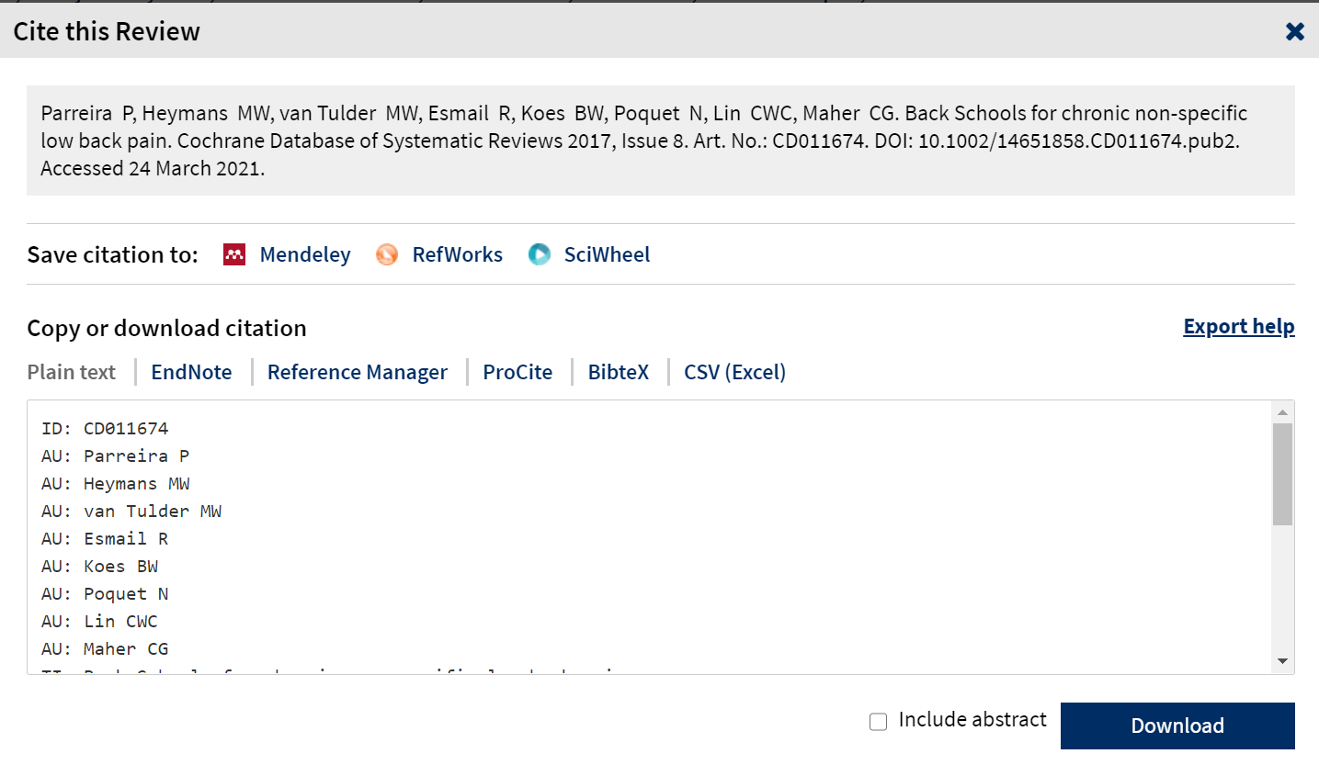
Export your search results
NEW FEATURES
CSV format added
Sciwheel (F1000Workspace) reference manager added
Export help:
Includes instructions for using the files with Reference Management programs and spreadsheet programs.

Slide 25
Cochrane Library: Key Features

Slide 26
Remember: access all content with a single search

Slide 27
Using filters to find relevant results

Slide 28
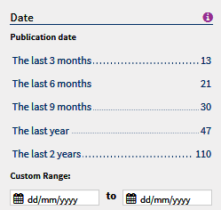
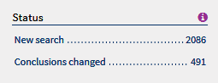
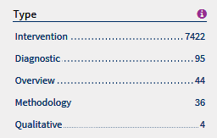
Filters specific for Cochrane Reviews
Date article was published online or added to the Cochrane Library
Status: Filters by events that have affected the review
Type: Used to identify the type of question addressed by the review

Slide 29
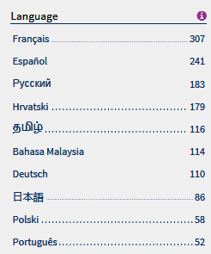
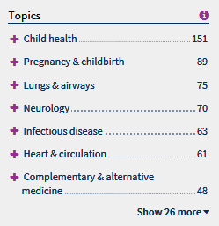
Filters for Cochrane Reviews
Language: Identifies when translations for content are available
Topic: Limit results based on Cochrane supplied topics

Slide 30
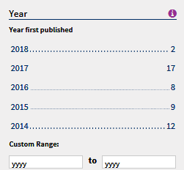
CENTRAL Filters
Date added to CENTRAL database
Publication year limit
Limits to articles sourced from PubMed, Embase, CT or WHO ICTRP

Slide 31
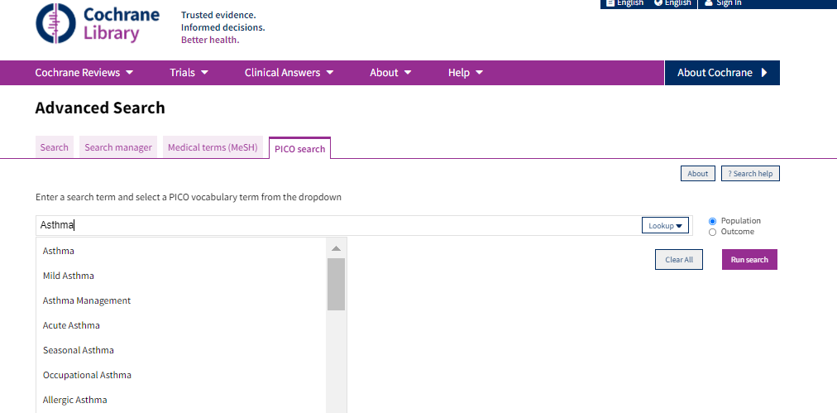
PICO search
Search Cochrane Reviews by
Population Intervention Comparison Outcome
....to find reviews that precisely match your research or clinical questions
1. Select the PICO search tab
3. Choose your PICO context
2. Enter a search term and select from the dropdown

Slide 32
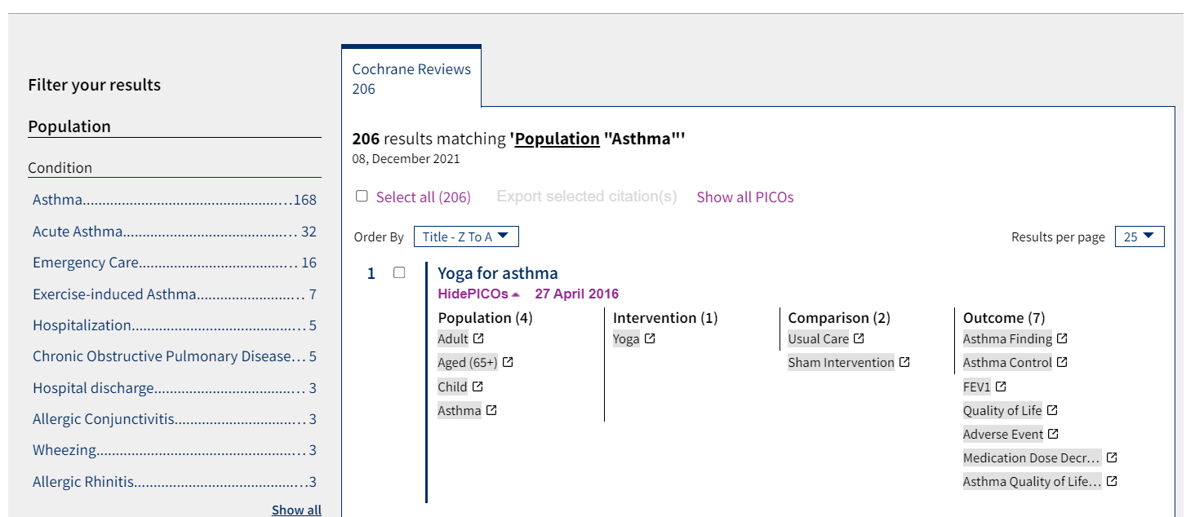
PICO search
PICO search Results
PICO based filters
View PICO terms in results to quickly identify relevant articles
Use PICO filters to refine searches
Display PICO terms in results

Slide 33
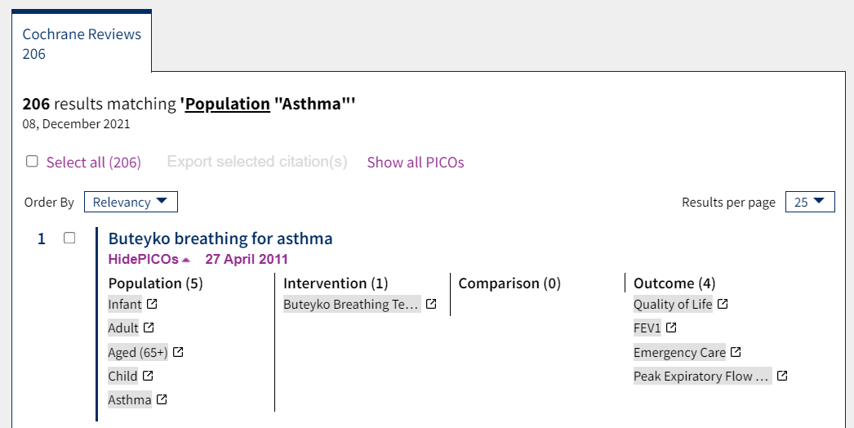
PICO search
PICO terms will also display in search results pages from all standard Cochrane searches
Use “View PICOs” to view PICO terms in search results
Use PICO terms in results to quickly identify patient populations and interventions you are interested in
Show PICOs on your search results page. Faster to read than an abstract!

Slide 34
Many New Links between content
Cochrane Database of Systematic Reviews
CENTRAL
Article
References
How Cochrane Used this article
Characteristics of studies
Article
Cochrane Clinical Answers
Related Content
Cochrane Podcasts

Slide 35
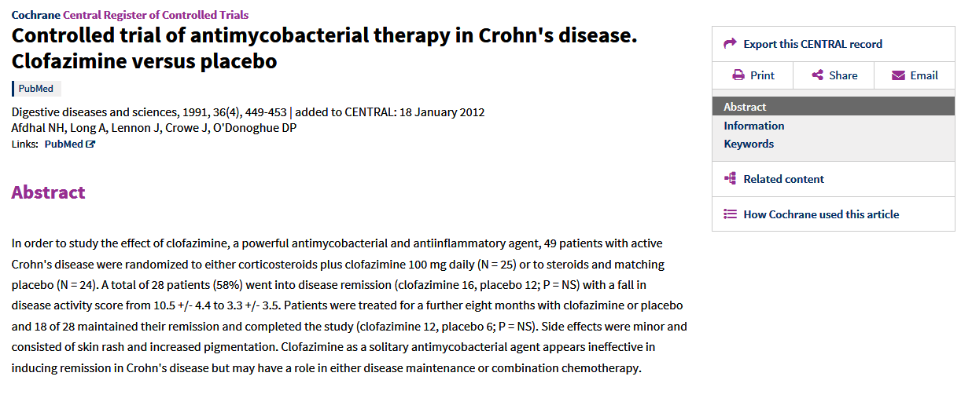
CENTRAL Article LINKED CONTENT
See how a CENTRAL article was used in specific Cochrane Reviews

Slide 36
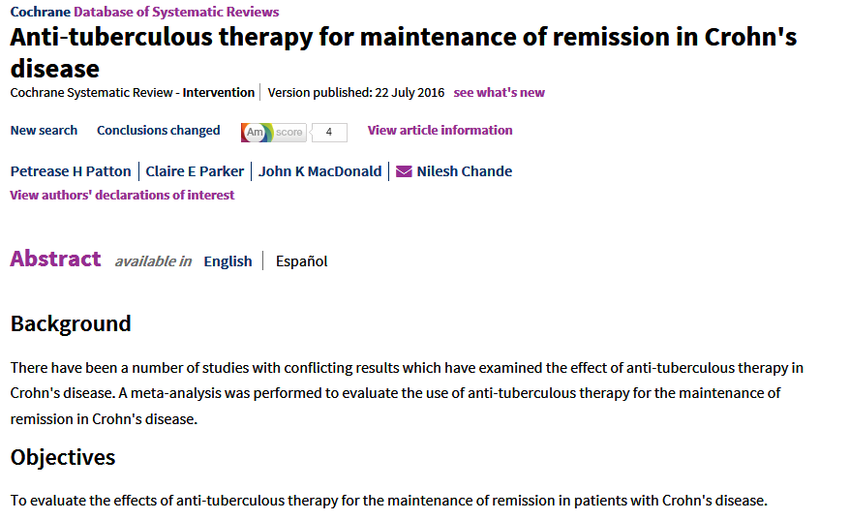
LINKED CONTENT
Select the title to link to the Cochrane Systematic Review the CENTRAL article was used in.

Slide 37
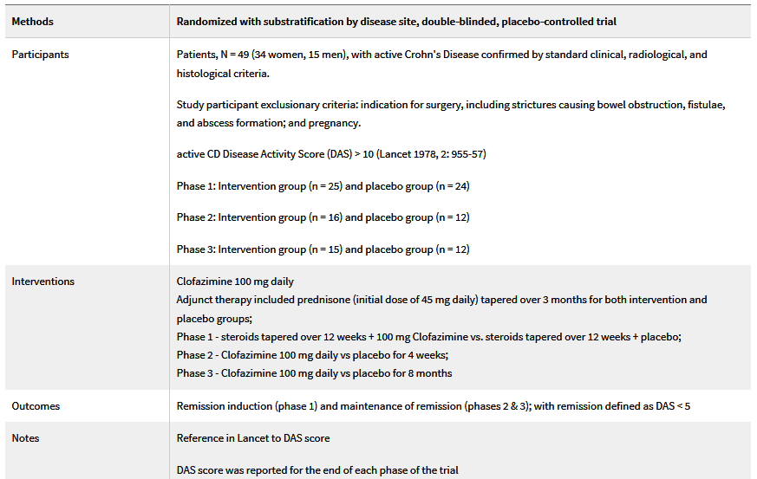
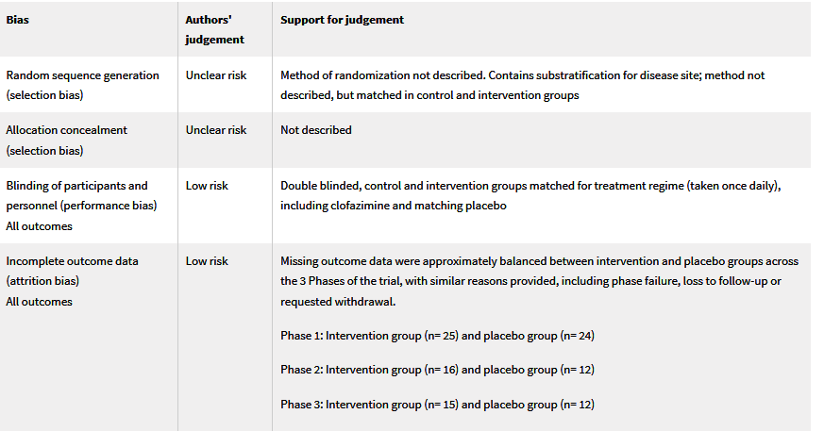
CENTRAL article LINKED CONTENT
Use this link to view the Cochrane PICO analysis and risk of bias for the article

Slide 38
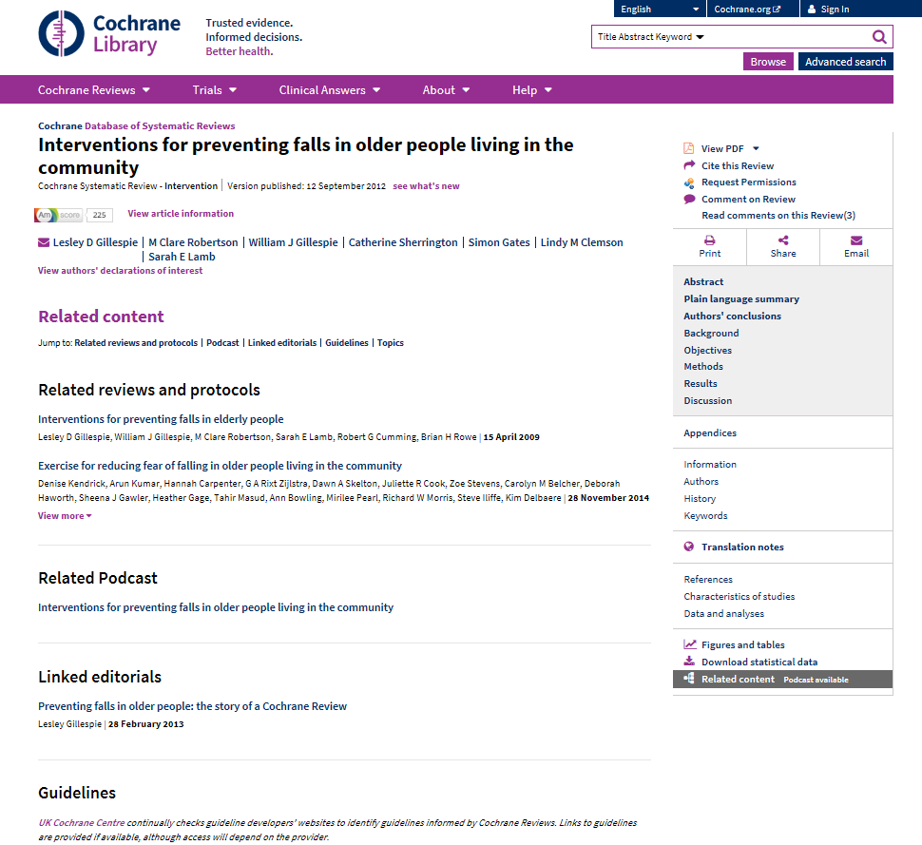
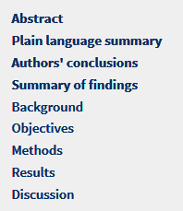
Systematic Review
LINKED CONTENT
Related Content links to podcasts, Cochrane Clinical Answers, related Cochrane reviews and guidelines

Slide 39
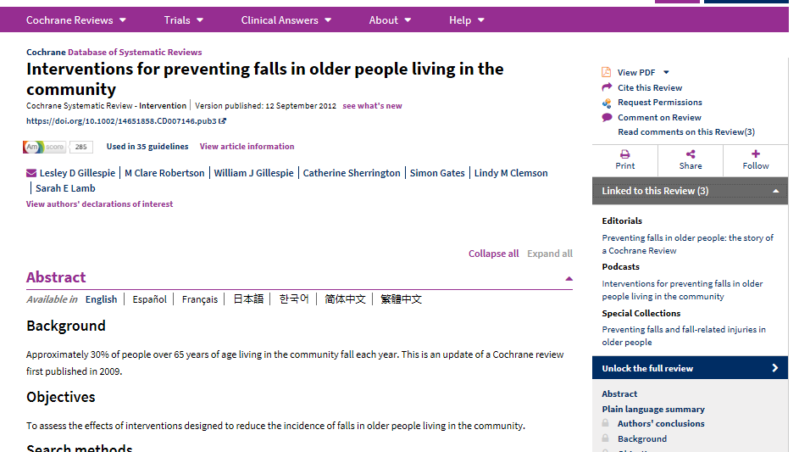
New links to find related Cochrane content and guidelines

Slide 40
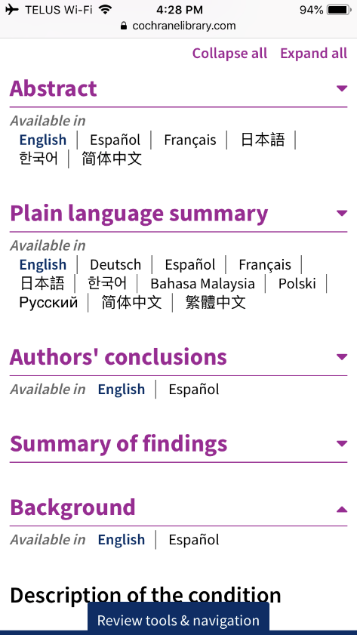
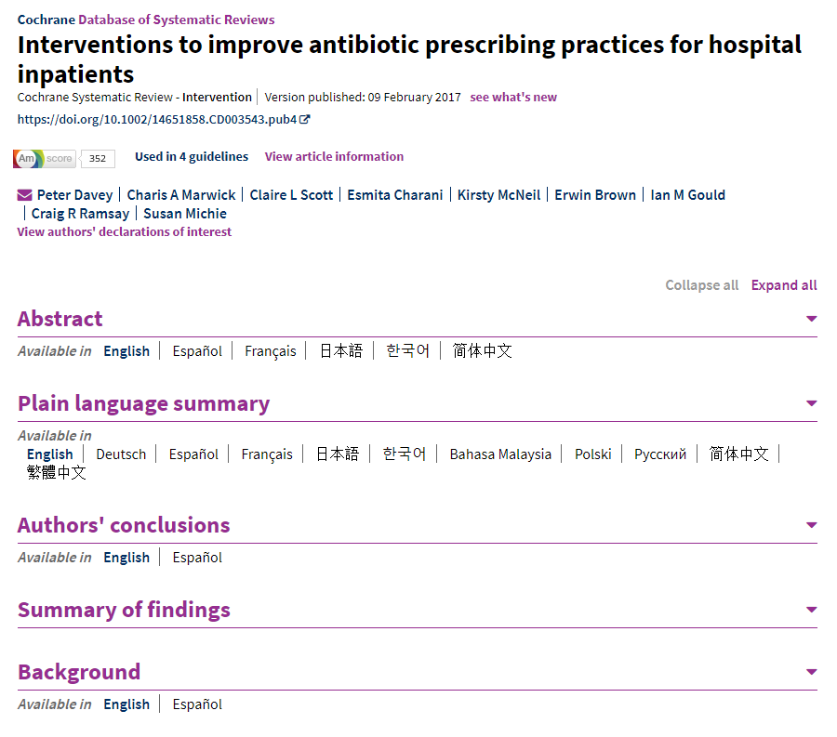
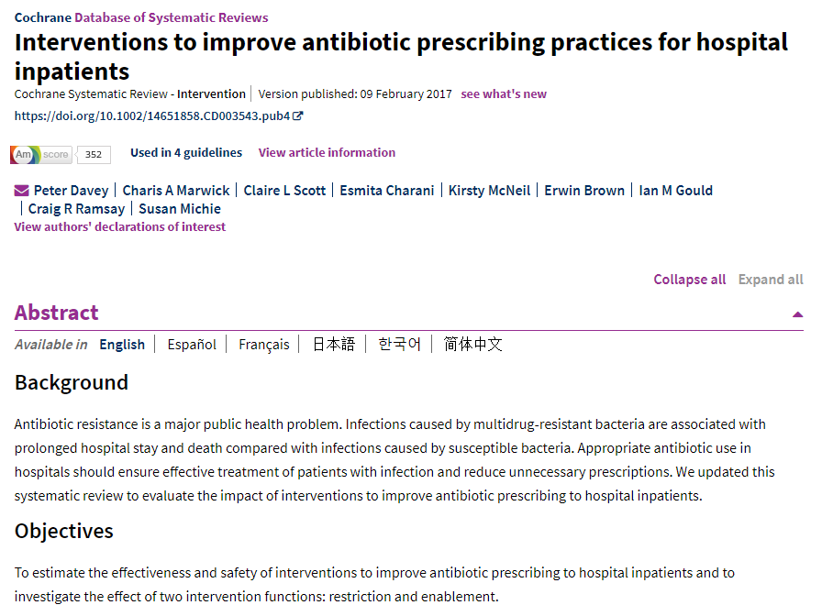
Navigation Update
Collapsible sections allows users to
Quickly navigate large reviews
Easily identify content with translations
Improves experience on mobile devices
Improved navigation on mobile devices

Slide 41
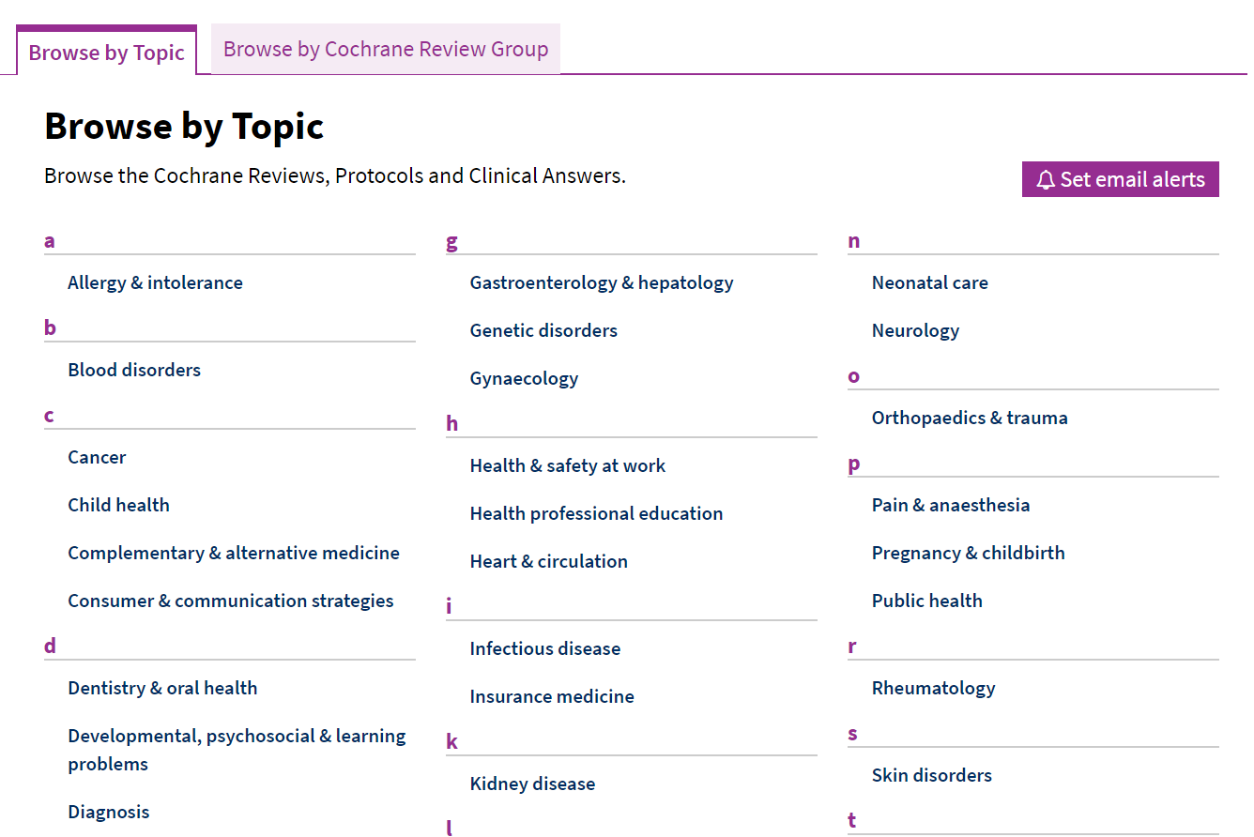
Email Alerts
Use Cochrane assigned topics to create alerts to monitor when new Cochrane Systematic Reviews on that topic are published

Slide 42
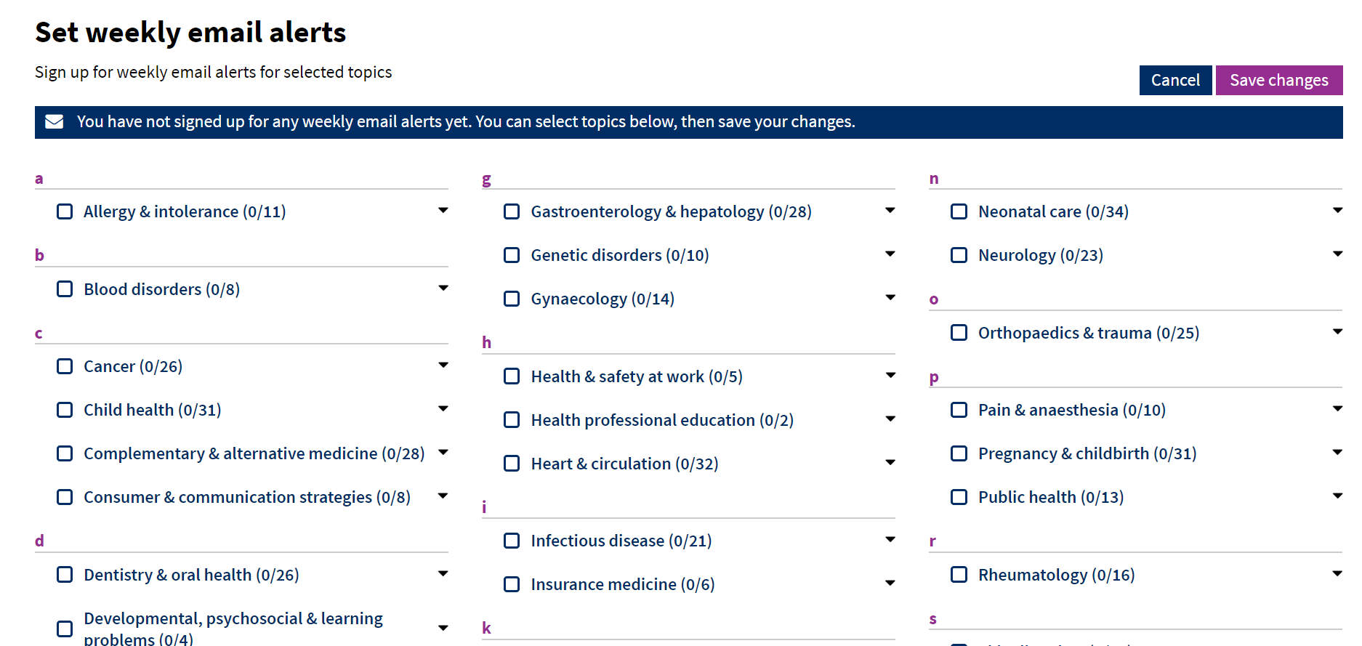
Email Alerts
Select as many fields as needed by checking the boxes

Slide 43
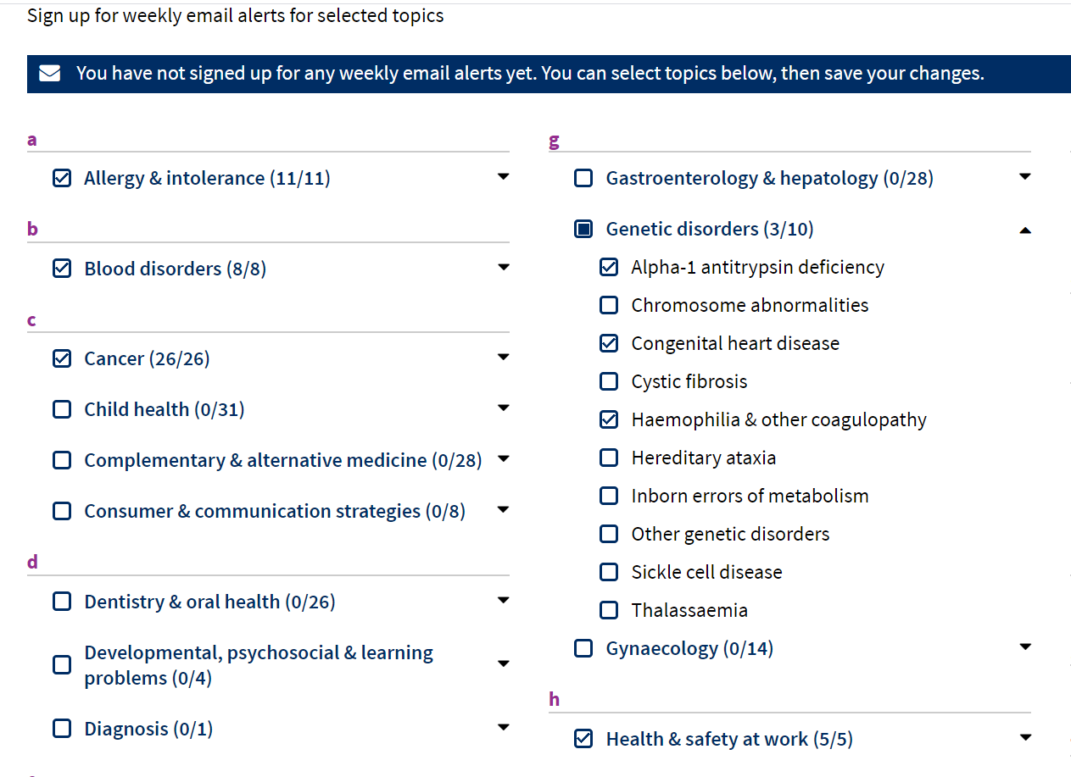
Email Alerts
Ability to select topics and subtopics by clicking the arrow

Slide 44
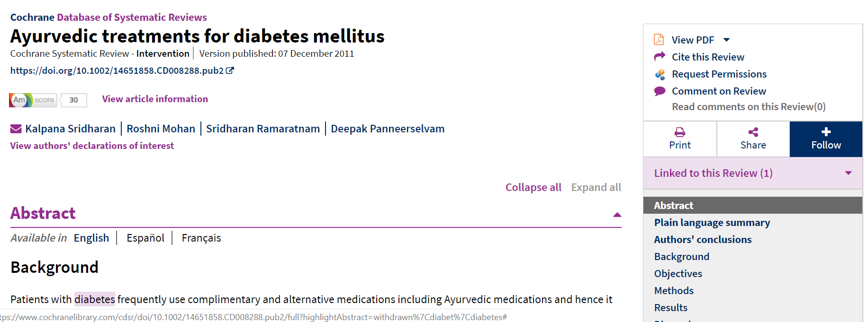
Following Reviews
Set up an alert to notify you when a specific systematic review is updated

Slide 45
Using the Cochrane Library: Live Demo

Slide 46
Thank you for listening! Questions? Trainer Name Trainer Contact Info

